Slide 1



Slide 2

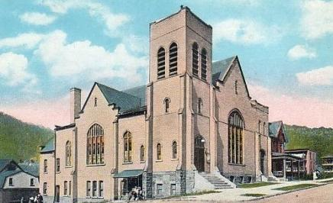
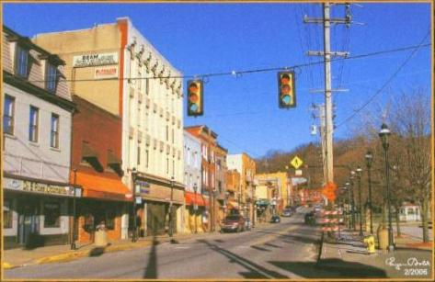

Slide 3
Poverty Defined
Situational Poverty – Poverty caused by a sudden change in circumstances
Generational Poverty – 2 of more generations of a family in poverty

Slide 4
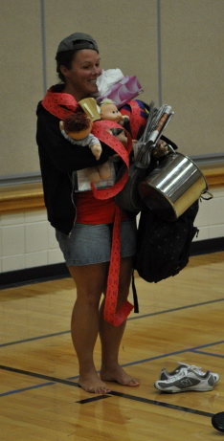
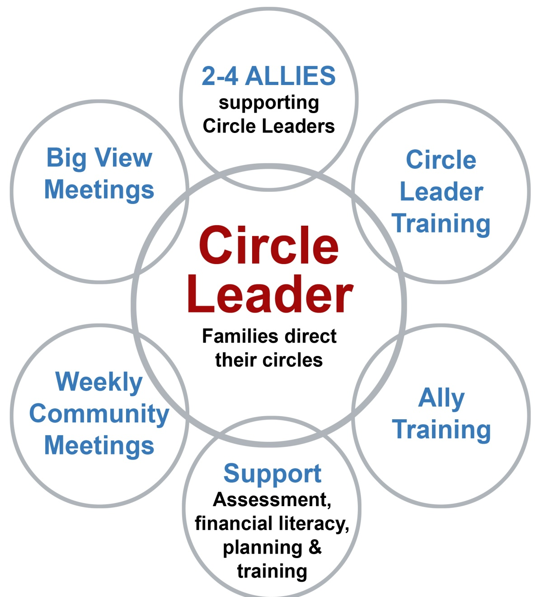
Circle Leader

Slide 5
Hidden Rules
 | Poverty | Middle Class | Wealth
Education | Valued and revered as abstract but not as reality | Crucial for climbing success ladder and making money | Necessary Tradition for making and maintaining connections
Language | Casual Register, language about survival | Formal Register, Language For Negotiation | Formal Register, language about networking
Driving Force | Survival, Relationships, entertainment | Work, Achievement | Financial, political, social connections

Slide 6


Poverty Programs

Slide 7
Development
Children from poverty typically are two years behind their peers from middle class and wealth and often aren’t ready for school.
Hart and Risley say it’s impossible to suddenly make up 20 million words when a child is 4 or 5, but we also know it isn’t ”over” for children who come to school with weak language

Slide 8
Language Experience and Development
Economic Class | # of words age 6 mo - 3 yr | Encouragement vs. prohibitions |  | Working vocabulary
Professional | 30 million | 5 | 1 | 1,200 at 36 months
Working Class | 20 million | 2 | 1 | No info
Welfare | 10 million | 1 | 2 | 900 for adults

Slide 9
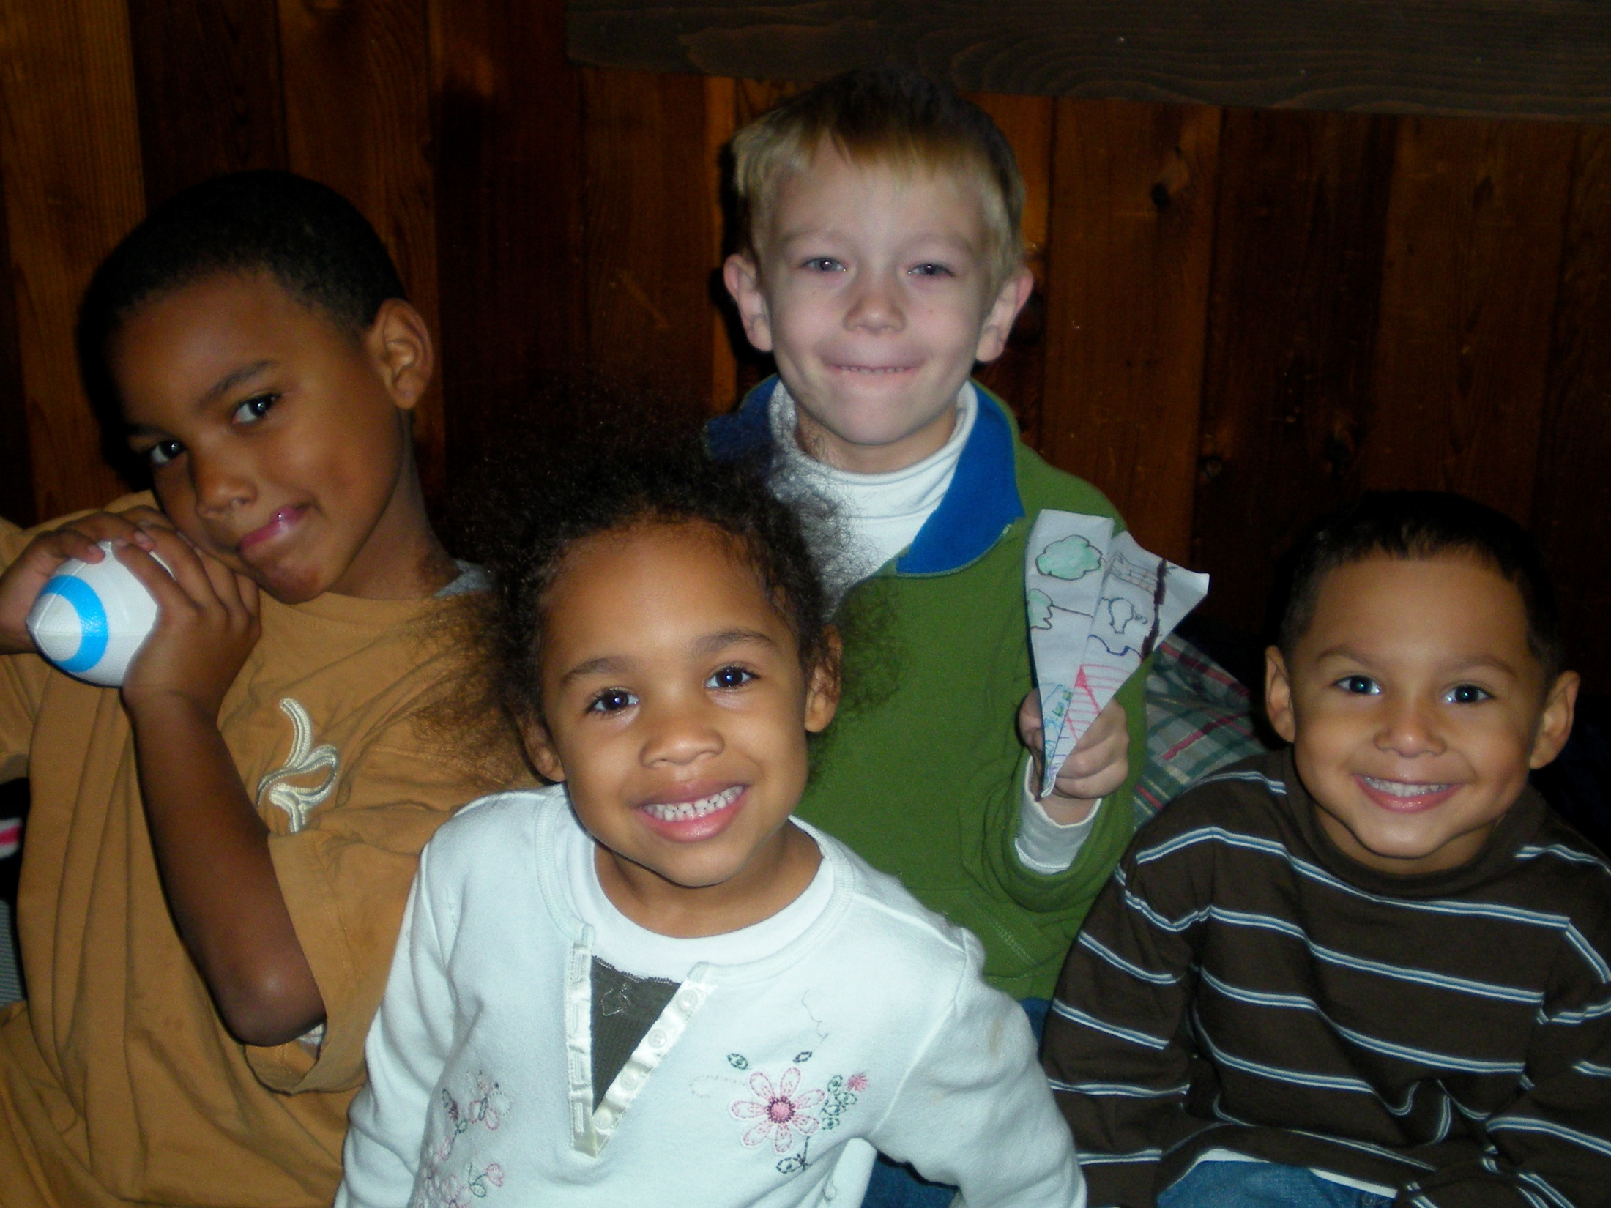

Slide 10
Mediation
What | Why | How
 |  | “Shut up. Be Quiet. Settle Down. Stop That”
“Hey, you’re standing up in your seat.” | “When the bus takes off, you might fall down.” | “So…why don’t you kneel down or sit on my lap.”

Slide 11
Poverty Redefined
Poverty and Middle Class and Wealth are all financial terms that describe people, cultures and family.
Getting Ahead looks at eleven resources that are all factors in Poverty; Mental, Emotional, Spiritual, Motivation, Financial, Integrity, Relational, Hidden Rules, Physical, Social, Language.
Poverty sometimes is the cause of things or a result of things such as Mental Health and Addiction

Slide 12
Implications
Students from poverty have needs that everyone can address.
Parents – more positive reinforcement, read around your kids and with your kids – lead by example
Teachers – take the Bridges Out of Poverty training a step further. We know what these students need. Ask, “How can we help their parents and community to have the resources and support they need to help their children?”
Community – after school programs are needed, safe and quiet places to get homework done with supportive mentors to help with academic success as well as behavioral success
WE can work together to make Achievement possible for any kid!

Slide 13
WHAT CAN YOU DO?
WHAT CAN PARENTS DO TO HELP KIDS IN POVERTY SUCCEED?
WHAT CAN TEACHERS AND ADMINISTRATORS DO?
WHAT CAN OTHERS IN THE COMMUNITY DO?

Slide 14


